Slide 1
Cognitive Hearing Science (CHS): Three memory systems, two approaches and one model: Humes keynote opening lecture, Tampa Florida, nov 3, 2019
Jerker Rönnberg

Slide 2
Cognitive Hearing Science (CHS):
CHS focuses on the subtle balancing act between what we traditionally call bottom-up, signal-driven and top-down, conceptually driven information
processing
(Audibility/Cognitive factors, Humes, JAAA, 2007)

Slide 3
Visual analogy of hearing impairment: the power of top-down processing
Cowboy

Slide 4
Social activity
Or a panda ?

Slide 5
THREE MEMORY SYSTEMS
Different memory systems play different communicative roles, and are part of top-down processing skills:
Episodic long-term memory (Episodic LTM) is a personal memory system, dated in time and space.
Semantic long-term memory (Semantic LTM) refers to general knowledge, without personal reference, e.g., scripts, vocabulary or phonology.
Working memory (WM) refers to an individual’s capacity to keep several things in mind, often involving storage of information, while doing some kind of semantic processing.

Slide 6
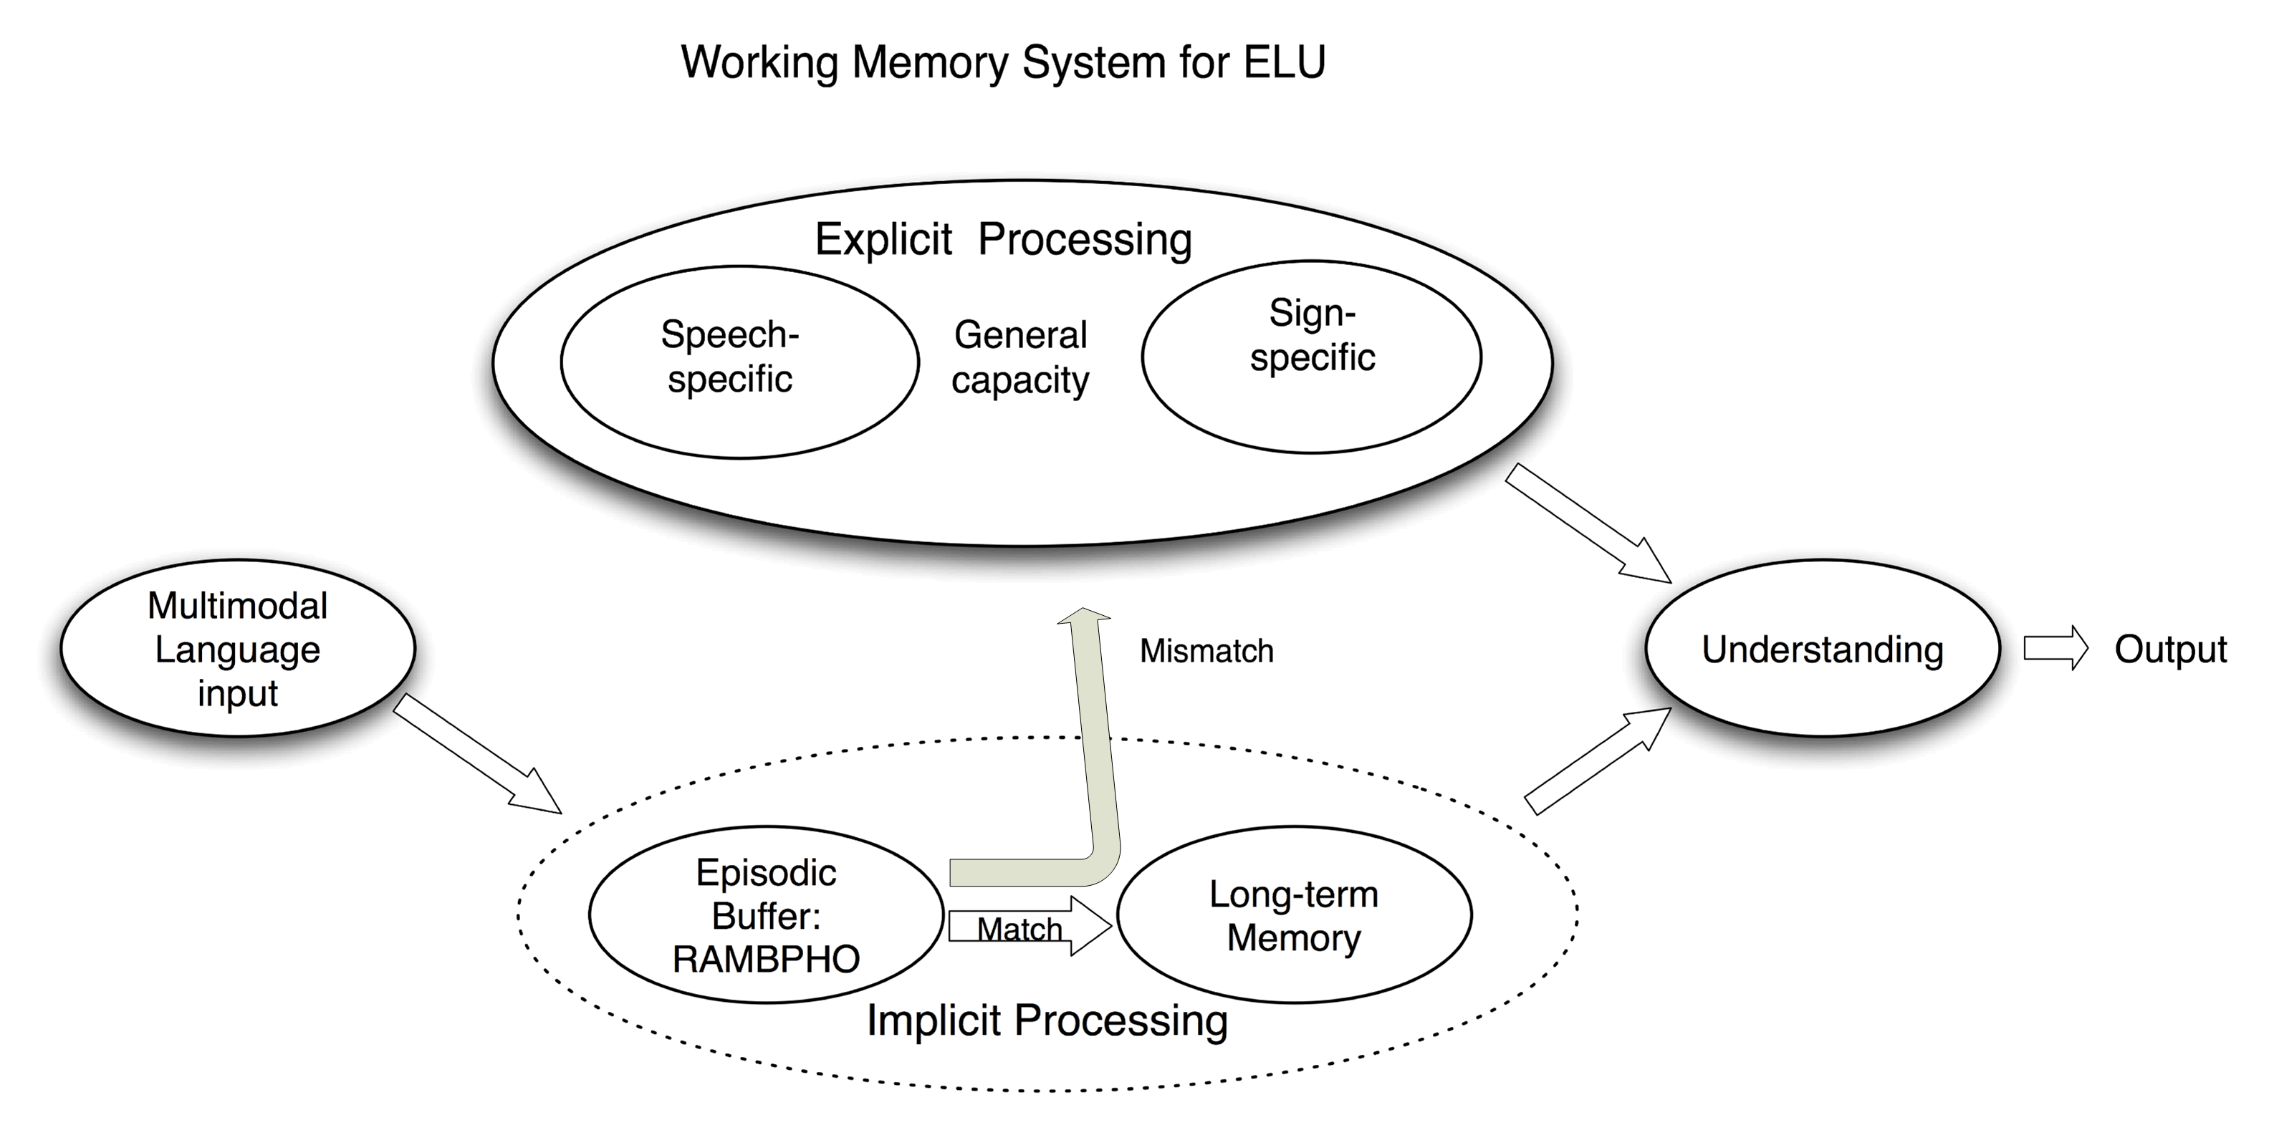
APPROACH I: WM system for Ease of Language Understanding (ELU)
ELU-framework: Rönnberg, 2003, Int J Audiol;
Rönnberg et al., 2008, Int J Audiol,
Rönnberg et al. 2010, Noise & H;
Rönnberg et al. 2011, JSHLR
Main prediction: Under adverse, mismatching, speech-in-noise conditions, speech understanding depends on explicit processing and storage capacities such as working memory (WM), typically tapped by the reading span test.

Slide 7
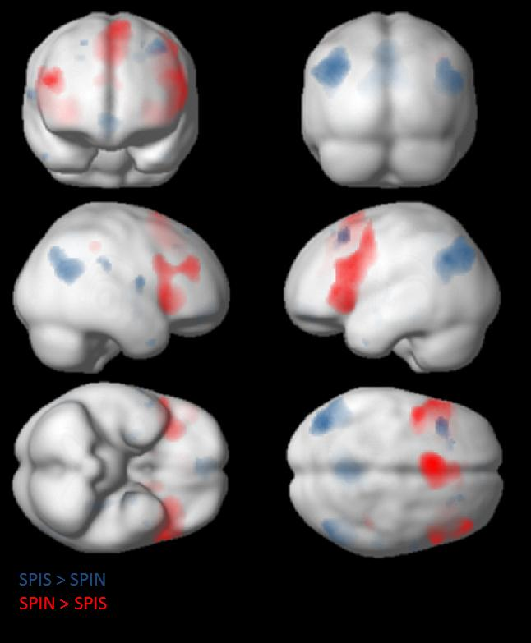
Red: speech in noise
Cognitive hearing, with increased mismatch (in red):
Zekveld et al. (2012), Brain & Lang.

Slide 8
Examples of Approach I
WM-dependence, especially for hearing-impaired participants and speech-like or speech babble backgrounds (e.g., Lunner, 2003; Ng et al., 2013; Rönnberg et al., 2016; Marsja et al., 2019; Zekveld et al., 2019).
When WM-dependence is reduced for acclimatization to one type of signal processing (e.g., SLOW compression in the hearing aid), then switching to FAST compression, causes phonological mismatch and higher dependence (Rudner et al., 2009; Souza et al., 2015, for a review).

Slide 9
Further examples of Approach I
WM-dependent concentration/ attention processes at the brain stem and cortical levels (Sörqvist et al., 2012; 2016).

Slide 10
Sörqvist, Stenfelt & Rönnberg (2012)
J Cog Neurosci 2012. (doi:10.1162/jocn_a_00275)
.

Slide 11
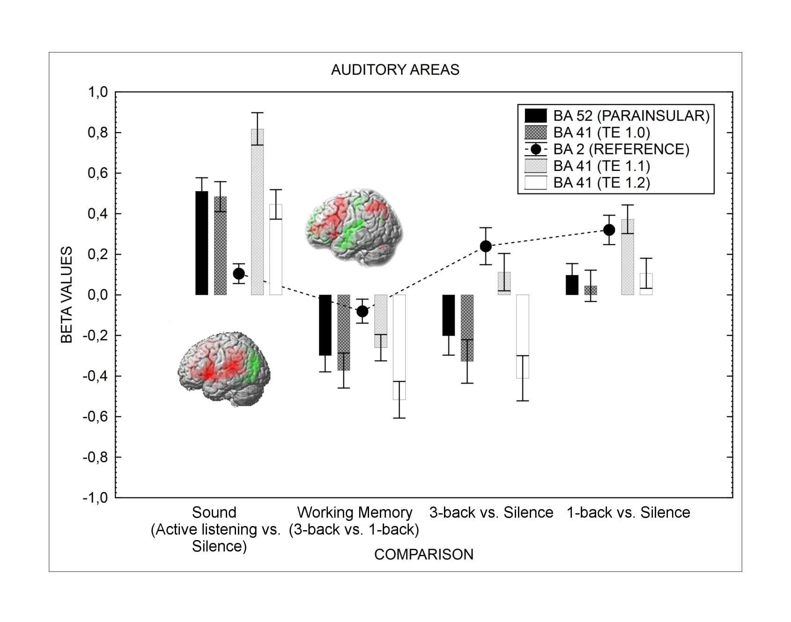
Concentration: a dynamic interplay
Sörqvist, Dahlström, Karlsson & Rönnberg (2016).
Frontiers in Hum Neuroscience. doi.org/10.3389/fnhum.2016.00221

Slide 12
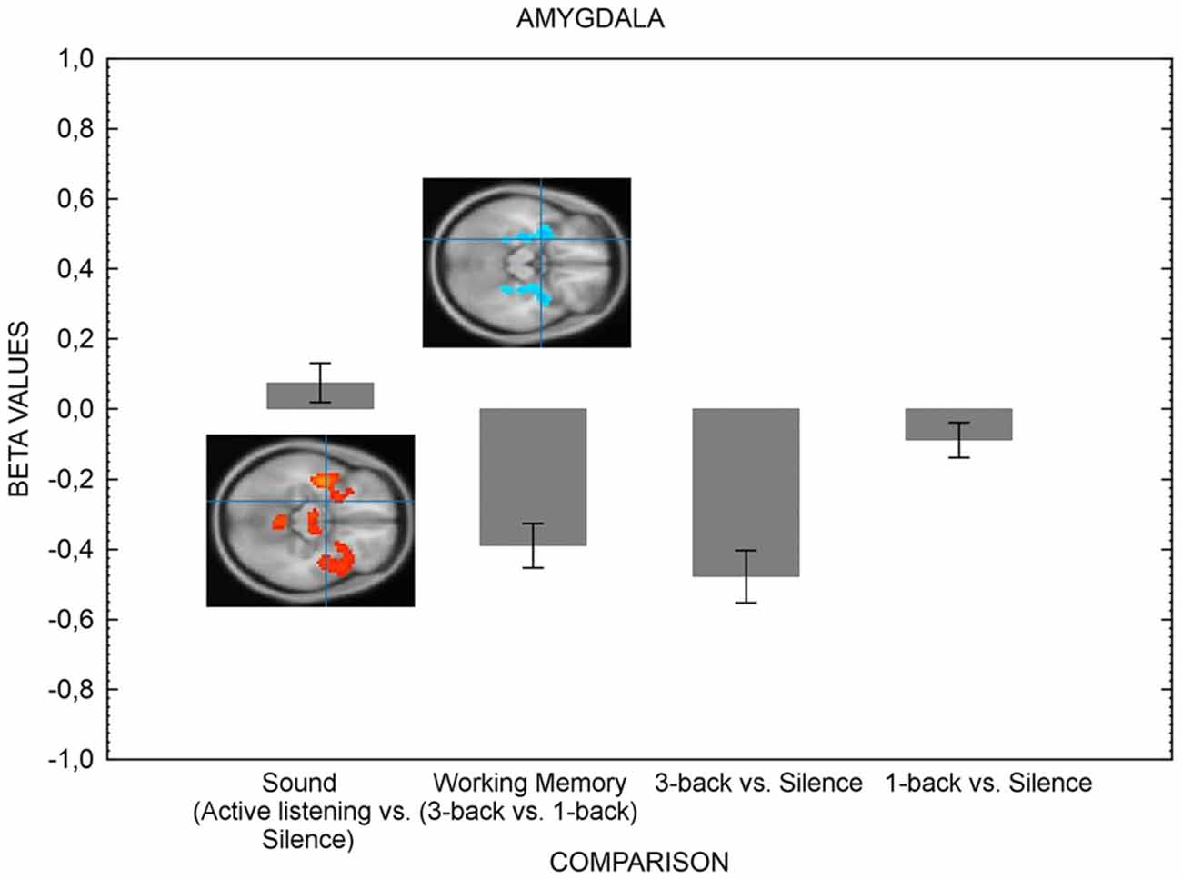
The dynamic interplay

Slide 13
Final example of Approach I
Sörqvist & Rönnberg (2012). Journal of Speech, Language, and Hearing Research, 55, 210-218.
High WMC gives reserve capacity for storing information in episodic LTM.
SIC span: Is an elephant larger than a mouse? Zebra
A good predictor of listening to a story in speech babble and Episodic LTM of what was said.

Slide 14
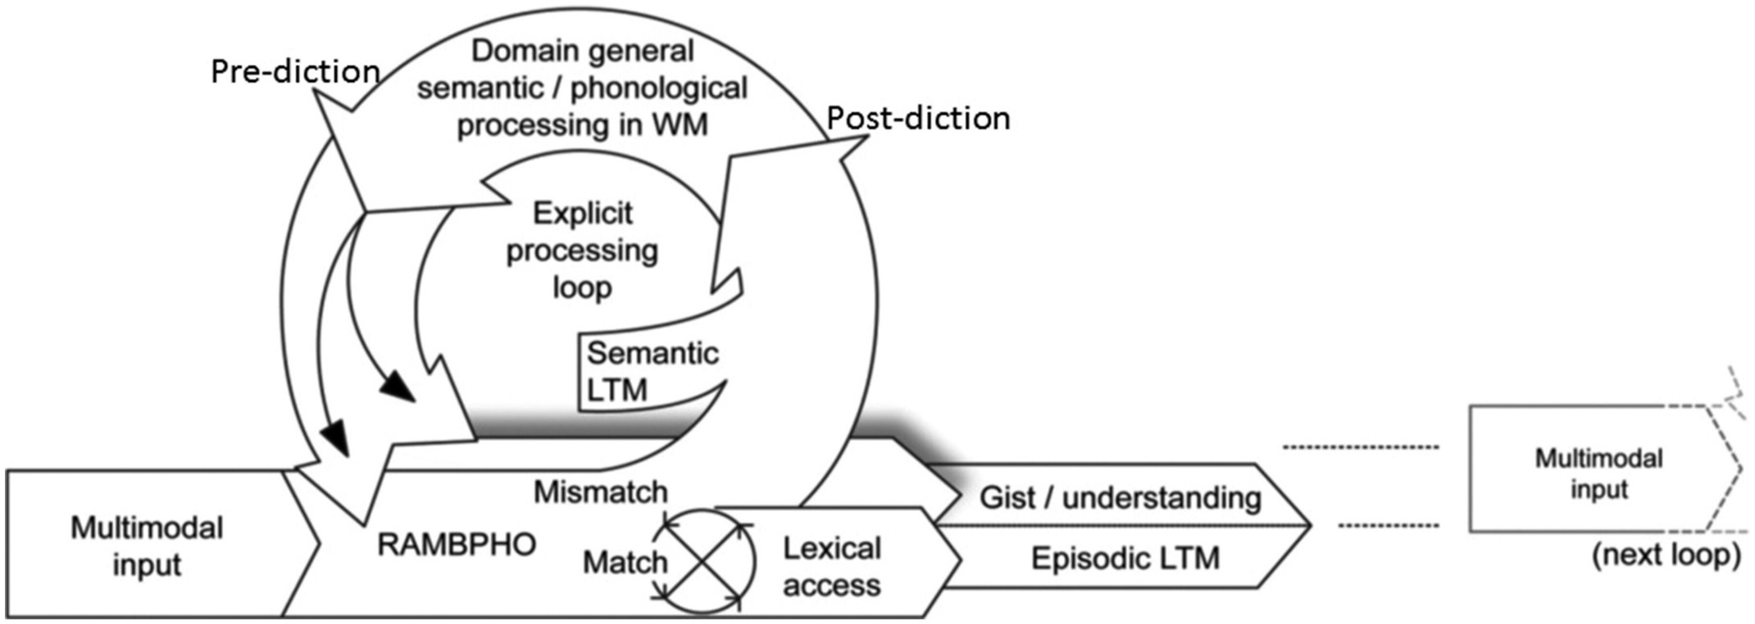
New ELU model: Rö, Holmer & Rudner, IJA, 2019; R et al., Front. Syst. Neurosci, 2013, R et al. IJA, 2016
Post-diction refers to reconstruction after mismatch
Pre-diction refers implicit priming and pre-tuning via RAMBPHO
Pre- and post both depend on WMC
High WMC affects gist/understanding and reserve cpacity for episodic LTM.

Slide 15
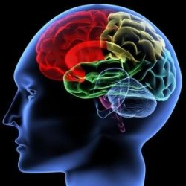
APPROACH II: Plasticity
PLASTICITY=
The ELU-model predicts a relative disuse of episodic , multimodal LTM (ELTM) compared to WM, with neural consequences.
Reason: WM is always used for postdiction, ELTM is used less because of fewer encodings/retrievals

Slide 16
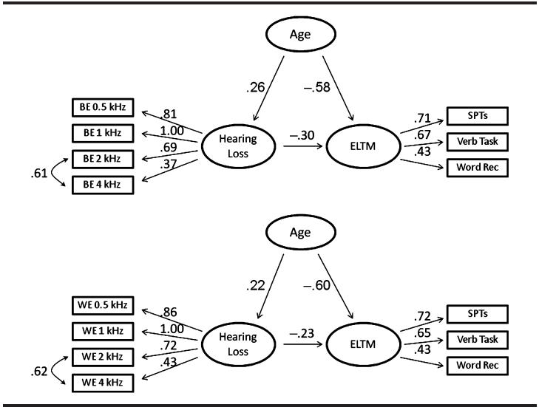

Slide 17
Approach II:UK biobank (memory)
N = 138 000, when age is controlled for, a measure of functional hearing (SRTs for reporting digits in noise at 50%) predicts a significant and negative effect on visual episodic LTM:
cf. the ELU prediction of disuse of multimodal memory systems. Hearing aid use had very limited effects
Rönnberg J, Hygge S, Keidser G and Rudner M (2014). The effect of functional hearing loss and age on long- and visuospatial WM: Evidence from the UK Biobank resource. Front. Aging Neurosci. 6:326. doi: 10.3389/fnagi.2014.00326

Slide 18
UK biobank (morphological)
In a large nonclinical cohort (n = 8,701, 52.6% female, 47.4% male) of middle-aged adults poorer SRTs—a measure of functional hearing—is related to lower gray matter volume in the whole brain and in predicted functional networks including the STG and frontal regions (not to parietal WM storage regions). SRTs is also related to reduced white matter volume in the hippocampus.
> This is in line with the ELU.
Rudner, M., Keidser, G., Johnsson, B., & Rönnberg, J. (2019). Poorer speech reception threshold in noise is associated with lower brain volume in auditory and cognitive processing regions. Journal of Speech, Language, and Hearing Research. doi.org/10.1044/2018_JSLHR-H-ASCC7-18-01

Slide 19
Further example related to Approach II
Other international studies claim that hearing impairment causes dementia of Alzheimer type (e.g. Lin et al., 2011, longitudinal study).

Slide 20
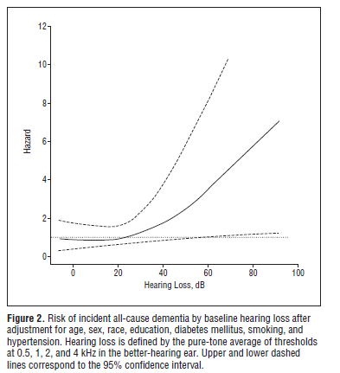

Slide 21
Hypothesis
We know that:
1. Cognitive aging: decline in episodic LTM is what is first affected in the development of dementia of the Alzheimer type
2. The same decline holds for functional hearing loss and is corroborated by the longitudinal Lin studies
3. Hearing loss is also connected to predicted morphological changes, Rudner et al. (2019).
Thus, we have a hearing-related mechanism that is potentially connected to dementia of the Alzheimer type.

Slide 22
New ELU model:
new data, some predictions and future
new kinds of signal processing and signal distortion draw on WMC (e.g. Arehart et al., 2013; Lunner et al., 2009; Foo et al., 2007). Even for high positive SNRs, WMC modulates short-term retention of spoken materials, the SWIR test (Ng et al., 2013; Souza et al., 2015). Future Research > task difficulty of SWIR, then signal processing more beneficial (Micula et al., (2019).
WMC is predicted to modulate “early” attention mechanisms ; brain stem data (Sörqvist et al., 2012a; cf. Kraus & Chandrasakaren, 2010; Kraus et al., 2012). Future Res: WMC and attention with different intention, refinement of brain measures.
D-ELU model (Holmer et al., 2016) is about how Semantic LTM representations are formed. We will continue this track (Ng & Rö, 2019)
4. WMC seems relatively more robust than other LTM memory
systems in response to impairment-related decline (Rönnberg et al., 2011; Rönnberg et al., 2014)
Future Res: Departing from Rudner et al., (2019), we will investigate the hearing-loss-hippocampal-episodic LTM connection in one study.

Slide 23
New ELU model:
Some future clinical projects
Develop clinically useful WMC tests (on-line and episodic LTM at the same time).
Using EEG signals for controlling the hearing aid, not just watching the speaker but using brain activity related to intention
Cognitive spare capacity: Episodic LTM for the contents of a conversation in noise
Longitudinal study, auditory/cognitive predictors of decline/dementia, n200
Intervention study: WM training > better SPIN performance, neural correlates

Slide 24
Thank you for listening!
www.headcentre.se

